Slide 1


Introduction to Data Analytics
Ironhack AMS
Ironhack AMS

Slide 2
What is Data Analytics?
Welcome
Collecting, cleaning and using data to generate actionable insights
Collecting: from other systems, from the web, through APIs
Cleaning: preparing for analysis
Using: finding patterns and relationships, modelling
Actionable Insights: conclusions we can act on, improvement suggestions
Ironhack AMS
Ironhack AMS

Slide 3
What is Data Analytics?
Welcome
Collecting, cleaning and using data to generate actionable insights
Collecting: from other systems, from the web, through APIs 5-10%
Cleaning: preparing for analysis 60-80%
Using: finding patterns and relationships, modelling 10-20%
Actionable Insights: conclusions we can act on, improvement suggestions 5-10%
Ironhack AMS
Ironhack AMS

Slide 4
Why do we need to clean data?
Welcome
Why don’t they just give us the good stuff?
Data is collected all the time, by almost every human activity:
Shopping: visiting a webstore; checkout; visiting a physical store
Travelling: check in/out on your travelcard; in your SatNav; in traffic-monitoring systems; when you book a trip
Sports: your FitBit or step counter; checking in to your gym; hawkeye in tennis
Building: land registry; permits
Business: sales; accounting
Paying for something: when was the last time you used cash for something bigger than a cup of coffee?
Ironhack AMS
Ironhack AMS

Slide 5
But the data is intended for operation, not for analysis.
Welcome
Which is why we get:
Typos - free format data entry
Missing values - non-mandatory fields
‘Other’ as a category
Invalid and incorrect data: dates, zipcodes, etc.
Outliers - ‘age=200’
Different data formats - legacy systems, multiple systems, corporate mergers
Ironhack AMS
Ironhack AMS

Slide 6
A data analyst spends up to 80% of their time in data cleaning
Welcome
Which is why I prefer to call it ‘preparing the data for analysis’.
Ironhack AMS
Ironhack AMS

Slide 7
So what is learning Data Analysis like?
Welcome
Ironhack AMS
Ironhack AMS

Slide 8


Like learning to draw

Slide 9



Welcome
Ironhack AMS
Drawings by me, 2017, 2018, 2018
Ironhack AMS

Slide 10
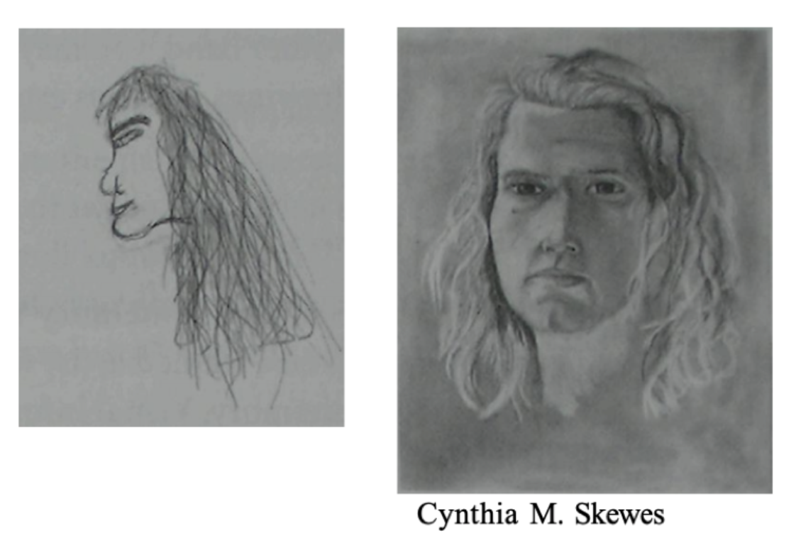
Welcome
From: Drawing with the right side of the brain - Betty Edwards
Ironhack AMS
Ironhack AMS

Slide 11
In drawing, we learn to draw what we see, rather than what we think is there
Welcome
Drawing a face is about learning to ‘see’ the patterns in front of us.
See the shades of light and dark
See the shapes
See the lines
Start drawing them in that order (shades, shapes, lines)
Only then go back to what they represent
Ironhack AMS
Ironhack AMS

Slide 12
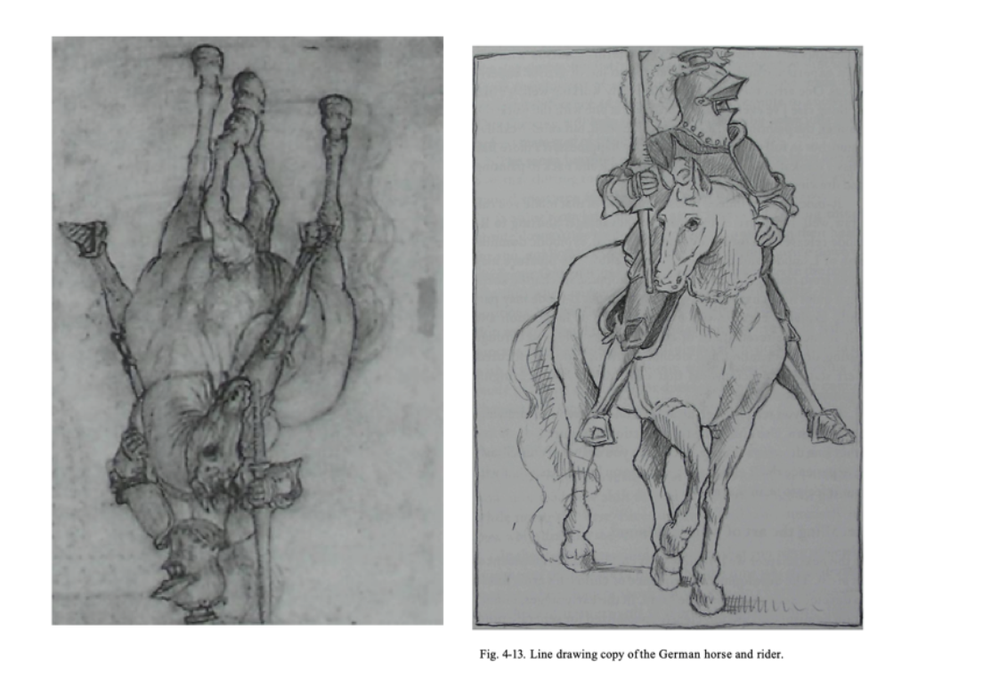
Welcome
From: Drawing with the right side of the brain - Betty Edwards
Ironhack AMS
Ironhack AMS

Slide 13
When copying a complex figure, drawing it upside down helps with this
Welcome
It forces us to:
See the shades of light and dark
See the shapes
See the lines
Start drawing them in that order (shades, shapes, lines)
Only then go back to what they represent - turn the image over
Ironhack AMS
Ironhack AMS

Slide 14
Welcome
“Learning to draw is about learning to see.”
Betty Edwards
Ironhack AMS

Slide 15
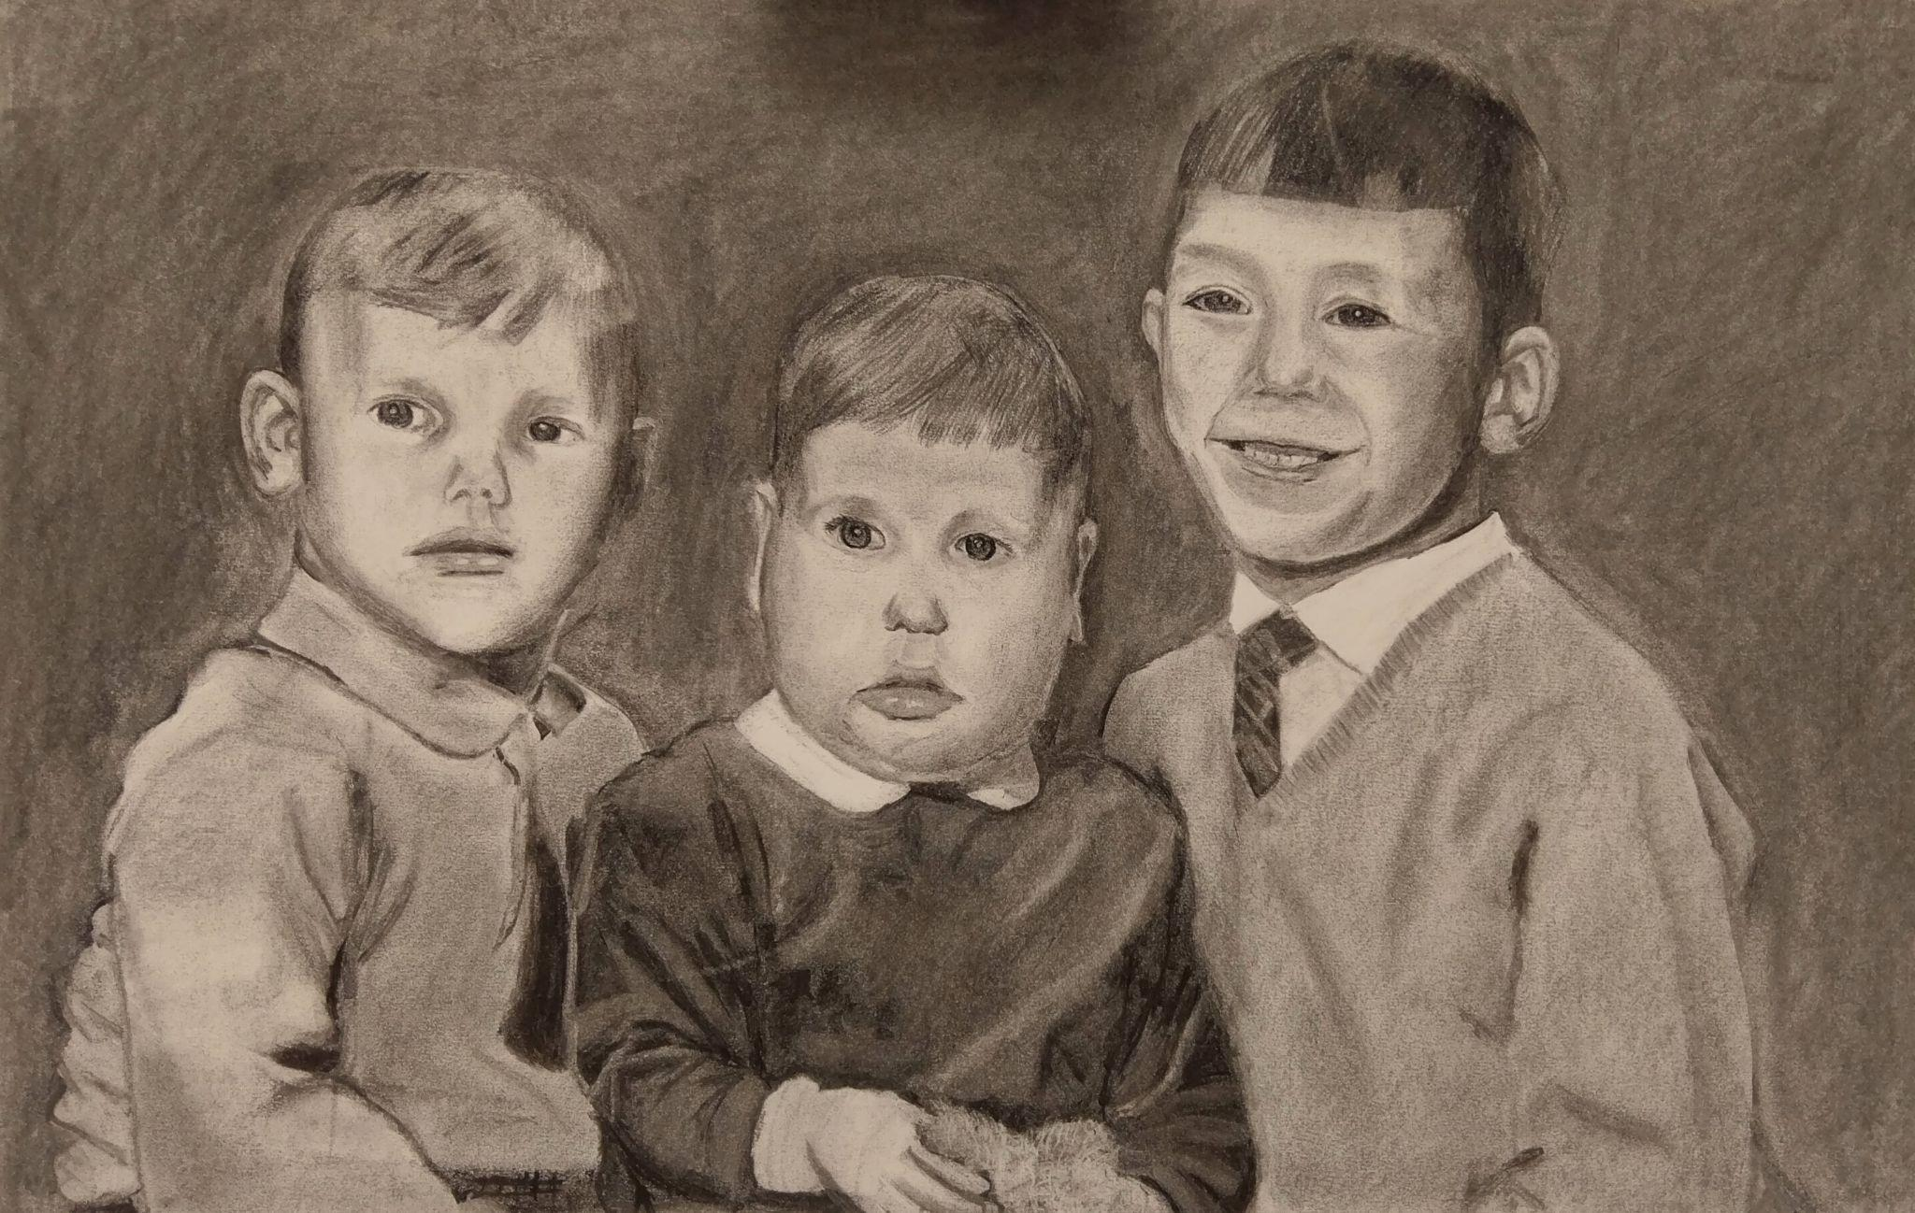


Welcome
Ironhack AMS
Drawing and paintings by me, 2020, 2021, 2022
Ironhack AMS

Slide 16
So, how about data analytics
Welcome
Understanding data is about learning to ‘see’ the patterns in the data.
See the numbers
See the relationships between them
Look at the numbers forgetting for now what we (think we) know about a subject
Only then go back to what they represent
Ironhack AMS
Ironhack AMS

Slide 17

Example
Welcome
Ironhack AMS
Ironhack AMS

Slide 18


The steps of DA
Question
Get the data
Clean data (i.e., prepare for analysis)
Observe the data
Visualise and present data and findings
Start answering the question
Predict the future - classify the present
Goal of DA: Actionable Insights
Welcome
Ironhack AMS

Slide 19
Welcome
Ironhack AMS

